Slide 1

Energy Consents Unit Nikki Anderson – Interim Head of ECU Ruth Findlay – Team Leader - ECU Alan Brogan – Team Leader (Legislation and Regulation) 27 February 2019
Notes:
Introduction and thanks for invite.

Slide 2
Energy Consents Unit
Who are we?
Where are we?
How to contact us?
What we do?
Where there is cross department interaction with DPEA
Overview of Current Generation Case Load
Necessary Wayleaves/CPOs
Wind Farms
Emerging issues
Variations
Close and Questions
Notes:
An overview of the contents of today’s presentation.
Signpost that questions will be taken at the end.

Slide 3
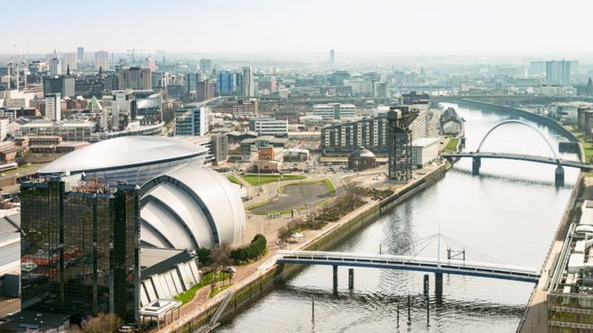
Head of Consents Nikki
Alan Brogan Team Leader
Legislation and Regulation
Ruth Findlay Team Leader
Consents
Nikki Anderson Team Leader
Consents
James McKenzie
Case Manager
Theresa McInnes
Case Manager
Mark Ashton
Case Manager
Stephen McFadden Case Manager
Debbie Flaherty
Case Manager
Lesley Tosun Senior Case Officer
Vacancy
Senior Case Officer
Chris Park Senior Case Officer
Josh McCormack Senior Case Officer
Tony Young Senior Case Officer
Joyce Melrose Admin Officer
Carolanne Brown Case Officer
Magnus Hughson Case Officer
Angela Doris Case Officer
Econsents_admin@gov.scot
www.energyconsents.scot
Notes:
Chat about the structure of the team and the other SG departments that support our functions like planning and architecture, SGLD and OCEA etc. Explain that we are based in Glasgow (Atlantic Quay) – refer to very indistinct arrow!! How we can be contacted at the attached email address and our case work can be viewed at www. etc. Explain how the case officer can be contacted by quoting the reference number and emailing us at the generic admin address.
Give a quick overview of the structure of the teams and discuss how representations are made with poor Joyce having the lion’s share of responsibility in recording and publishing representations in respect of our applications.
Overview of other work handled general enquiries in respect of the case work – Ministerial briefings, media enquiries, requests under FoI etc. input into other team’s and their policy work.

Slide 4
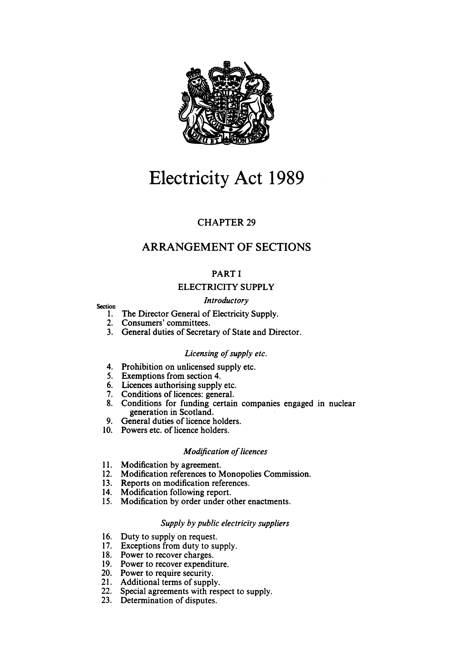
What We Do
Applications for consent for the construction, extension and operation of electricity generating stations with a capacity in excess of 50 megawatts (applications below this threshold are made to the relevant local planning authority);
Applications for the installation of certain overhead electric lines and associated infrastructure;
Applications for necessary wayleaves to confer rights over land to install electric lines;
Compulsory purchase orders promoted under the Electricity Act 1989;
Applications for consent for large gas and oil pipelines.
Such applications cover new developments as well as modifications to existing developments.
Notes:
Go through the slide.
Explain that all of the team have responsibility for a mix of applications.
Explain that application fees have recently been reviewed and that increases are expected to be implemented sometime in May 2019 – this now includes fees for variations. That we can’t charge fees for NWs, CPOs or pre-application processes like scoping, screening, inception meetings etc.

Slide 5

GENERATION – CURRENT CASELOAD
ECU - SECTION 36
February 2019 - 75 “Applications”
Notes:
Our section 36 applications – i.e. applications for consent for the construction, extension and operation of electricity generating stations with a capacity in excess of 50 megawatts represent (in process terms) our biggest interaction with DPEA – although not in volume, the gold medal in that category goes to necessary wayleaves which we will talk about later.
This chart represents our current case load. I say case load rather than applications because not all of the cases referred to here represent “formal” applications – some are proposed applications that we have sight of in advance of scoping or where applicants don’t intend to formally scope.
These generally relate to wind farm generating stations although there has recently been a solar farm consented by Ministers and there are now a couple of Hydros back again in the mix
A fair bit of our resources are used in pre-app (as you can see from the chart) out of those 44 pre-app - 15 are pre-scoping or screening. There are Benefits of early engagement with developers – it allows the case officers to get to know the application in advance of its submission and it allows us as a team to have a bigger overview of cumulative impacts of the developments. 10 of those pre-app are about to be submitted and will be out to consultation soon where details will available on our website allowing members of the public to interact with the process.
A larger number than ever before of our case load is taken up by variation applications. We’ve seen increases in these applications over the last 2 years – 8 or so with us with more in the pipeline.
Since 2007 – 124 section 36 determinations have been made – approx. 47 of these were referred to PLI (approx. 38%) although over the last 5 years this figure has risen to 50% (28 out of 55).
Since 2007 – approx. 47% have resulted in a refusal (22 out the 47). Again that figure rises very slightly in the same 5 year period with exactly 50% being refused (14 out of 28).
We can therefore estimate that roughly 40- 50% of our applications will result in a PLI – with the odd exception these are almost always a wind farm. With a resulting 50% of these ending in a consent. It’s difficult to predict at the moment if the increasing number of variation applications will have an impact on the amount of referrals to PLI – we’ve not really had enough to analyse any trends yet. We’ll speak a bit more about these applications later on in the presentation.

Slide 6
Transmission and Distribution
Notes:
What the slide represents – the volume of applications other than applications under section 36 or section 36c submitted to Ministers. Section 37 applications without an EIA are generally dealt with under delegated authority by officials in ECU and as far as I am aware there have never been any referrals to PLI? For section 37 applications with an EIA – the number of applications are fewer over all and the amount referred to PLI even lower still (approx. 3 since 2007 I think - 2 of those formed part of the Beauly Denny transmission line).
Necessary Wayleaves by far represent the biggest volume of applications that make their way to the DPEA and result in cross departmental engagement – although arguably they are not quite as interesting to the wider public as section 36 applications are - nor as technically complex– although I guess that depends on who you are!
Hand over to Alan to Alan to talk a bit more about Necessary Wayleaves and CPOs

Slide 7

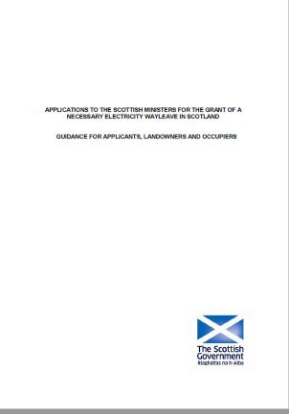
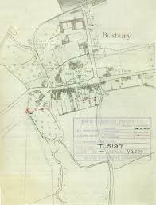
Necessary Wayleaves – Background and Process
Statutory powers under the Electricity Act 1989
Account for the majority of ECU interactions with the DPEA
Process guidance published by the Scottish Government in 2014 – set out process to be followed
ECU/DPEA developed efficient processes for transfer of documentation
Further improvement in process hindered by legislative restrictions

Slide 8
Necessary Wayleaves – Statistics and DPEA interactions
 | C/Forward | Intake | Total Available | Processed | Determined | Withdrawn | Average Process Time (Determined) months | Average Process time (W/drawn) months | Total Average Process Time in Months | Outstanding
Necessary Wayleave 2014 | 46 | 20 | 66 | 33 | 3 | 30 | 16 | 15 | 16 | 33
Necessary Wayleave 2015 | 33 | 58 | 91 | 28 | 9 | 19 | 11 | 19 | 15 | 63
Necessary Wayleave 2016 | 63 | 24 | 87 | 69 | 0 | 69 | 0 | 7 | 7 | 18
Necessary Wayleave 2017 | 18 | 35 | 53 | 13 | 3 | 10 | 9 | 10 | 10 | 40
Necessary Wayleave 2018 | 40 | 57 | 97 | 40 | 13 | 27 | 20 | 13 | 16.5 | 57
Total |  | 194 |  | 183 | 28 | 155 | 14 | 13 | 13
Of the 57 outstanding, 34 are with the DPEA.
Number of ‘bulk’ applications increased – transmission project timescales, large housing developments.
Fair and expeditious process for all parties – sists in exceptional circumstances only.

Slide 9

Compulsory Purchase Orders
Interactions few and far between
Average of 1 case referred to DPEA per year since 2013
Referred for Public Local Inquiry where a statutory objection is made (1947 Act)
Rights of landowner or occupier balanced against the public interest in determining whether the order should be confirmed
Other rights of licence holders - Tree Cutting Orders – no cases received to date

Slide 10
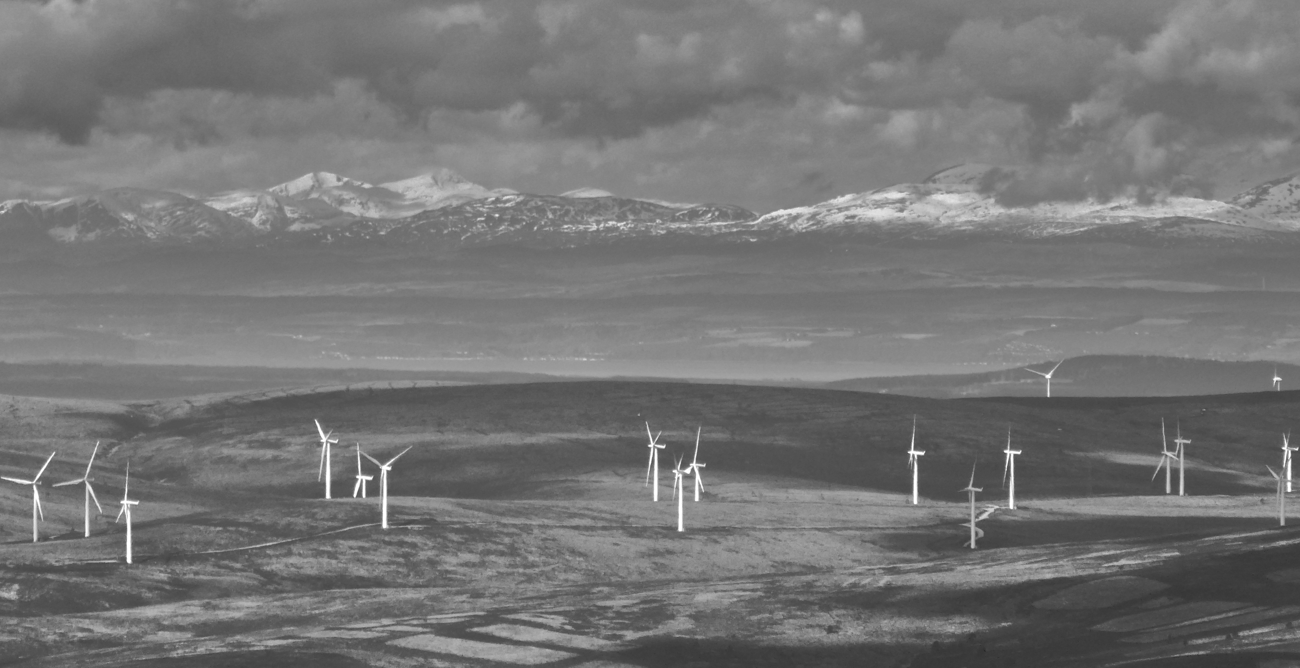
Energy Consents Unit interaction with DPEA
Section 36 Applications for Onshore Wind Energy Developments_
Process between Energy Consents Unit and DPEA and comparative process with Planning Authorities and DPEA
Section 36 Applications for onshore wind referred to the DPEA
Emerging issues for wind energy development
Notes:
Overview slide of what I am going to talk about

Slide 11
Process flow comparison
Generating Capacity in excess of 50MW | Generating Capacity up to of 50MW
Electricity Act 1989 | Town and Country Planning (Scotland) Act 1997
The Electricity Works (Environmental Impact Assessment) (Scotland) Regulations 2017 | The Town and Country Planning (Environmental Impact Assessment) (Scotland) Regulations 2017
The Electricity (Applications for Consent) Regulations 1990 | The Town and Country Planning (Development Management Procedure) (Scotland) Regulations 2013
Screening and /or Scoping Opinion Scottish Ministers | Screening and or Scoping Opinion to Local Planning Authority (LPA)
 | Proposal of Application Notice and Pre-Application Consultation
Application to Scottish Ministers | Application to Local Planning Authority
Details published on Scottish Government website and LPA website http://www.energyconsents.scot/Default.aspx | Details published on LPA planning register
Representations and consultation responses to Scottish Ministers | Representations and consultation responses to LPA
Changes – additional/ further environmental information | Changes – additional/ further environmental information
LPA is one of a range of consultees | Local Planning Authority is decision maker under Town and Country Planning (Scotland) Act 1997 and Planning etc (Scotland) Act 2006
No maximum prescribed timescales | Major Application – 4 months, Local Application 2 months Right of appeal against non-determination
Inquiry if planning authority objects on time and objection cannot be overcome by condition OR otherwise expedient | Inquiry on appeal
DPEA make recommendation to Scottish Ministers | DPEA make final decision
Scottish Ministers are decision maker under the Electricity Act 1989
Notes:
This a process flowchart comparing the journey of a windfarm application through the two different consenting authorities, i.e. a planning authority and Scottish Ministers and providing information on the applicable legislation. As a statutory consultative body, in respect of a section 36 application (e.g. a windfarm which generates in excess of 50MW) to Scottish Ministers, the Local Planning Authority will consider such applications against their relevant local development plans and guidance and provide a response to Scottish Ministers.
Outside if the mandatory requirement to refer an application to PLI if the relevant planning authority objects within the prescribed time period, Ministers also may refer an application to PLI, after considering any objections, if they consider if appropriate to do so.
Scottish Ministers are decision maker assess the application in accordance with Schedule 9 of the Electricity Act

Slide 12
Onshore Wind Energy Section 36 Applications referred to DPEA 2007 - 2018
Notes:
Over last 11 years 45 Section 36 applications out of a total of 94 applications submitted have been referred to DPEA.
Graph provides a break down of these figures.

Slide 13

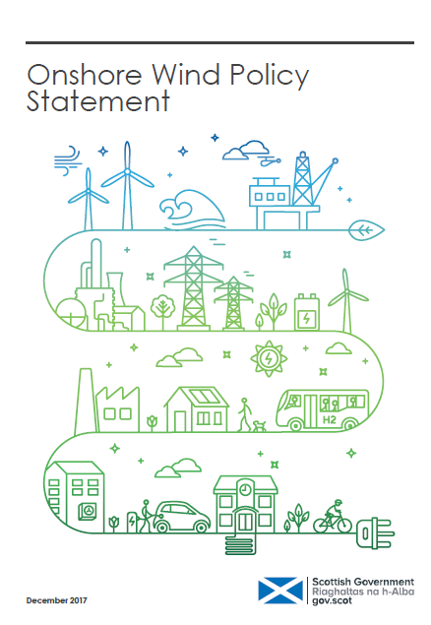
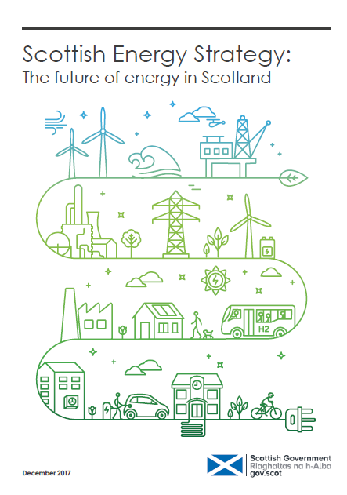
Emerging Issues
Scottish Government supports onshore wind energy development in appropriate locations
A challenge to industry,
in partnership with Scottish
Government, is to develop onshore
wind in Scotland without subsidy
Section 36C Variation Applications under the Electricity Generating Stations (Applications for Variation of Consent) (Scotland) Regulations 2013
Increase in tip height, aviation lighting
Notes:
Key message from Energy Strategy published Dec 2017 and Onshore Wind Policy Statement Dec 2017 – support for onshore wind energy developments in appropriate locations
The Energy Strategy sets out a vision for the future energy system in Scotland through to 2050. It sets out the priorities for an integrated system-wide approach that considers the use and supply of energy for heat, power and transport. The strategy sets out two new targets for the Scottish energy system by 2030 – (1) the equivalent of 50% of the energy for Scotland’s heat, transport and electricity consumption to be supplied from renewable sources; (2) an increase by 30% in the productivity of energy uses across the Scottish economy. The strategy provides a long term vision to guide energy policy decisions to tackle the challenges of decarbonising heat and transport in order to meet Scotland’s long term energy and climate change targets. The OWPS reaffirms the vital role for onshore wind in meeting Scotland’s energy targets. The statement sets out the Scottish Government’s position for the ongoing need for more onshore wind development and capacity in locations across Scotland where it can be accommodated.
Section 36C variation applications coming forward – emerging issues are Tip heights increasing and Aviation Lighting
Variation applications are currently with ECU and may be referred to DPEA for PLI in the future – covering variations for life extension, height increases. Each proposal considered on a case by case basis.

Slide 14
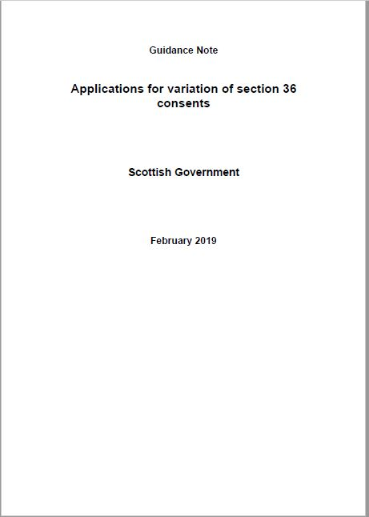
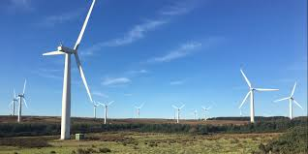
Variation applications – section 36C
High rate of enquiries from developers seeking to vary existing s36 consents – project viability
8 section 36C applications expected so far in 2019
EIA regulations amended in December 2017
Previous update 2015 -Requirement to update guidance
Overview of updates
where proposed variations will not have significant adverse effects on the environment, then there is no requirement for the change to be subject to EIA
If EIA, report should be produced which presents the likely significant effects of the whole development as it would be if varied.
DPEA interaction
Discretionary PLI – 2 referrals to date but increase expected

Slide 15
The End….
Questions ??????
Notes:
Thank everyone for listening – explain how some of the essential information is on the hand outs of the presentation that Diane helpfully printed off (email address - comparison of planning and s36 etc) and invite questions?

